Slide 1

Enhancing student engagement IN ENGINEERING COURSES THROUGH PERSONALIZED BOOK RECOMMENDATIONS
BATCH -111
Notes:
NOTE:
To change the image on this slide, select the picture and delete it. Then click the Pictures icon in the placeholder to insert your own image.

Slide 2

TEAM MEMBERS OF BATCH - 111
CH.ASHWINI (2103A52028)
T.SAIPRIYA (2103A52110)
B.SHASHANKA (2103A52005)
K.MADHUSREE (2103A52090)
M.PRANAVI (2203A52L02)
Under the Guidance of
Ms Faiza Iram
Assistant Professor
School of Computer Science and Artificial Intelligence, SR University

Slide 3
ABSTRACT
The System provides tailored reading recommendations for academic purpose. The project, named “Enhanching Student Engagement in Engineering Courses through Personalized Book Recommendations”, covers a wide range of book genres and is intended to benefit students in a number of academic subjects, such as computer science, electronics, artificial intelligence . It makes use of two main approaches: content-based filtering, which proposes books based on a students search history and preferences, and collaborative filtering, which makes book recommendations based on the tastes of students by combining various methods. In addition, the system tackles issues like data sparsity and the cold-start problem, which involves making recommendations for new users. Metrics like as recall and precision are used to evaluate the system’s efficacy in making suggestions that correspond with students’ academic level.

Slide 4
INTRODUCTION
A book recommendation system is a type of software designed to suggest books to users based on their preferences, behaviors, and other contextual data. These systems are widely used in online bookstores, libraries, and educational platforms to help users discover relevant books and reduce the time spent searching for resources. They aim to enhance user experience by providing personalized suggestions that match each user’s interests, past interactions, and sometimes even their unique goals. our project "Enhancing Student Engagement in Engineering Courses through Personalized Book Recommendations" aims to improve learning experiences for engineering students by leveraging personalized content delivery. In today’s interdisciplinary academic environment, students from diverse fields such as Computer Science, Electronics, and Artificial Intelligence require tailored resources that align with their academic and personal interests. This system addresses that need by offering book recommendations across a wide variety of genres using advanced filtering techniques. This approach not only enhances academic engagement but also addresses key challenges such as the cold-start problem for new users and data sparsity. By focusing on precision and relevance, the system aims to significantly contribute to student success and engagement across multiple disciplines.

Slide 5
DOMAIN KNOWLEDGE
To develop this book recommendation system for engineering students, key domain knowledge includes:
1. Engineering Books :Familiarity with engineering disciplines, common textbooks, academic levels, and interdisciplinary topics.
2. Machine Learning: Understanding recommendation algorithms (collaborative, content-based, hybrid) and evaluation metrics like precision and recall.
3. Natural Language Processing (NLP):Skills in text processing, topic modeling, and keyword extraction to analyze book content and metadata.
4. Recommendation System Techniques: Knowledge of collaborative and content-based filtering, hybrid approaches, and solutions for cold-start and data sparsity problems.

Slide 6
MOTIVATION
Our motivation for undertaking this project came from our own experiences. As engineering students, we often struggle to find the right books to study. With so many options, it can be confusing and difficult to to decide what to read. We want to create a recommendation system that helps other students, especially our juniors, find books that match their interests and learning needs. This system will save time, reduce confusion, and keep students motivated by showing them the best resources for their studies, whether they're in computer science, electronics, or any other engineering field.

Slide 7
PROBLEM STATEMENT
students often struggle to find the right books for their courses and academic needs.
With so many resources available, students can feel confused and waste time trying to choose the best book to read.
There's also a challenge for new students who don't have much reading history, which makes it harder to recommend books to them.
Most book recommendation systems are too general and don’t consider the specific needs of students in these specialized fields.

Slide 8
OBJECTIVES
Developing a Personalized Recommendation System: Creating a system that provides book suggestions tailored to students' courses, intrests, and branches.
Address Cold-Start Problem: Implement strategies to recommend books to new students by there branch
Enhancing Book Discovery: Improving the process of finding high-quality, course-specific books, reducing time spent searching for resources by rating of the books.
Improving User Experience: Building a user-friendly interface for students to easily access and navigate their book recommendations.

Slide 9
Existing systems & Disadvantage of existing methodology
Existing book recommendation systems often give general suggestions that don’t really fit the needs of engineering students.
These systems usually use one of two methods: content-based filtering, which recommends books based on similar titles, or collaborative filtering, which suggests books liked by users with similar tastes. However, they don’t personalize recommendations for specific courses and often overlook the latest resources available.
our proposed method improves the recommendation process by there branch and using the books that students have previously searched for, creating a more personalized experience.
Our system combines both content-based and collaborative filtering techniques to suggest relevant textbooks and the latest resources specifically for different engineering courses.
Our system also suggest new available books to explore and learn.

Slide 10
GAPS IDENTIFIED
Lack of Personalized Recommendations for Engineering Students:
Current book recommendation systems do not focus on the specific needs of engineering students, particularly across different branches like computer science, mechanical engineering, and electronics and so on.
Cold-Start Problem for New Students: suggesting books for new users and student is quite difficult.
Difficulty in Finding Relevant Books: There is no efficient system for students to easily discover books that are directly relevant to their specific courses and academic interests, leading to time wastage and confusion.
Data Scarcity in Engineering Fields: There is a lack of sufficient data about engineering textbooks and student preferences in certain specialized fields, making it challenging to build a high-quality recommendation model.

Slide 11
LITERATURE REVIEW
SNO | paper title | Authors | model used | Demerits | Future Scope
1 | A systematic review and research perspective on recommended system | Roy, Deepjyoti and Dutta, Mala | Collaborative Filtering >Content-Based Filtering>Matrix Factorization >Deep Learning models | May introduce bias in study selection and quickly become outdated due to rapid advancements in the field | Recommended systems are rapidly evolving, focusing on real-time machine learning for dynamic recommendations, advanced AI for enhanced nationalization, and solutions for data sparsity and cold start problems.
2 | Graph neural networks in recommender systems | Wu, Shiwen and Sun, Fei and Zhang, Wentao and Xie, Xu and Cui, Bin | >GraphSAGE >PinSage | They can be computationally intensive and require extensive data preprocessing, which may limit scalability and accessibility. | Wu, Shiwen and Sun, Fei and Zhang, Wentao and Xie, Xu and Cui, Bin

Slide 12
SNO | Paper title | authors | Model used | demerits | Future scope
3 | Machine Learning based Efficient Recommendation System for Book Selection using User based Collaborative Filtering Algorithm | Madhuri Kommineni; P. Alekhya; T. Mohana Vyshnavi; V. Aparna; K Swetha; V Mounika | >>user-based collaborative filtering >Deviation from Mean Method >Pearson correlation | .the cold start problem, where recommendations are weak for new users or books with few ratings. | the system includes the integration of hybrid models that combine content-based and collaborative filtering to improve recommendations for new users or books. The paper also suggests incorporating deep learning techniques like autoencoders for more complex preference modeling and leveraging distributed computing to enhance scalability
4 | An Online Book Recommendation System Based on Web Service | Binge Cui; Xin Chen | collaborative filtering >content-based approaches | The system's reliance on web services could lead to privacy concerns or network issues affecting performance. Additionally, its recommendation quality might depend on available data, limiting effectiveness in sparse datasets. | The paper suggests improving accuracy through hybrid models or incorporating deep learning techniques. Expanding the dataset and refining the system for better user profiling are also potential advancements.

Slide 13
5 | Book Recommendation System Using Opinion Mining Technique | Shahab Saquib Sohail; Jamshed Siddiqui; Rashid Ali | >Assigning weights to features based on user opinion >opinion mining >sentiment analysis | The reliance on text reviews means the system may struggle with incomplete or misleading data, and it can be computationally intensive to analyze large volumes of text. | The reliance on text reviews means the system may struggle with incomplete or misleading data, and it can be computationally intensive to analyze large volumes of text.
6 | Book Recommendation System for Digital Library Based on User Profiles by Using Association Rule | Pijitra Jomsri | >UCL Model >association rule mining | Association rule mining can become computationally intensive with large datasets, and the system may struggle with new users (cold-start problem). | Integration of hybrid models and machine learning techniques could improve scalability and real-time recommendation
7 | OWA based Book Recommendation Technique | Shahab Saquib Sohail a, Jamshed Siddiqui b, Rashid Ali b | >owa >combines expert rankings using weighted aggregation methods | One challenge of this approach is its scalability. As the dataset grows, the method may become less efficient, particularly in dynamic recommendation environments | Future improvements could involve integrating deep learning techniques with OWA for better scalability and accuracy. Combining this method with real-time user feedback and hybrid recommendation models could enhance adaptability and performance across diverse domains

Slide 14
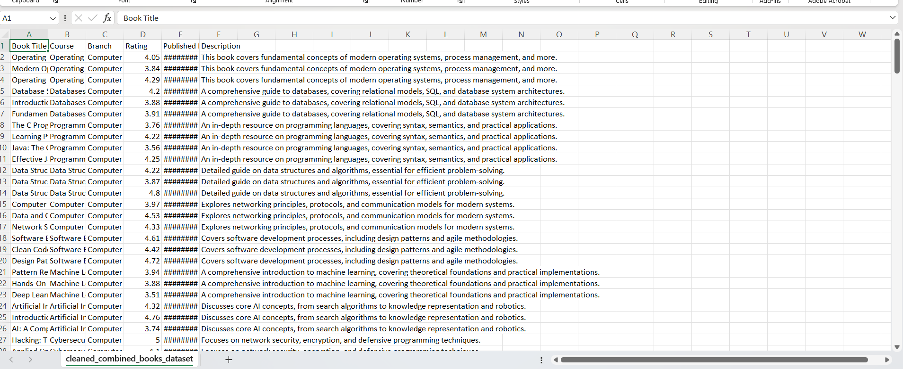
DATASET AND ITS DESCRIPTION
We prepared this dataset by collecting book information like title, course, branch, rating, published date, and description of every book from college library and internet resources like google.
Book title, course, branch, rating, published, description are features in our dataset.

Slide 15
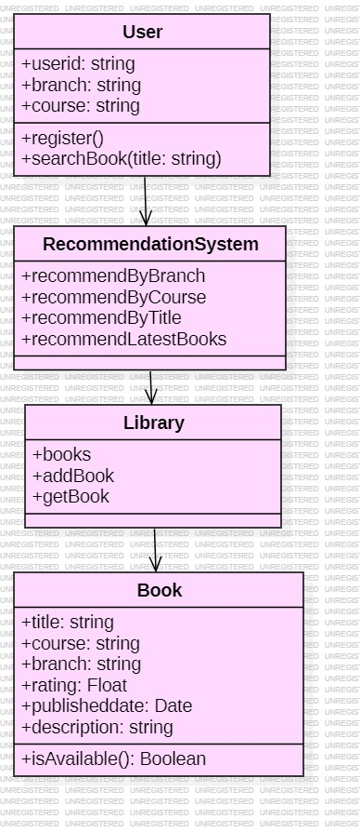
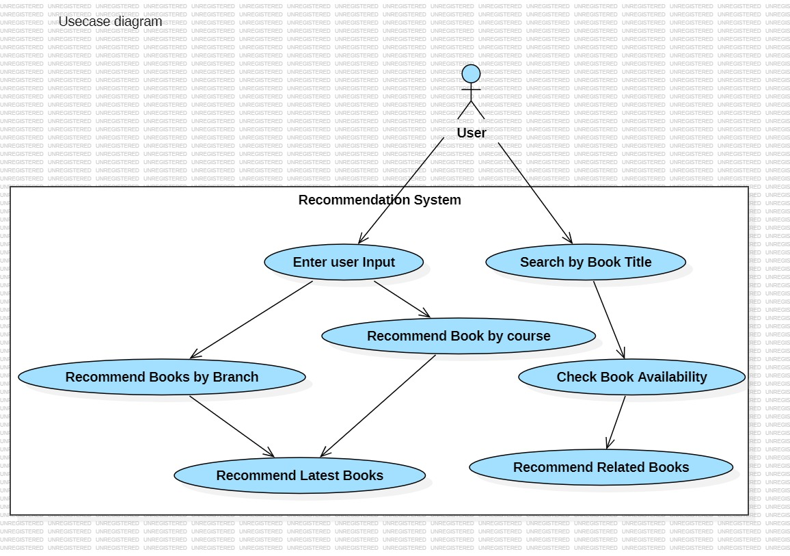
UML DIAGRAMS
Fig: class diagram
Fig: Usecase diagram

Slide 16
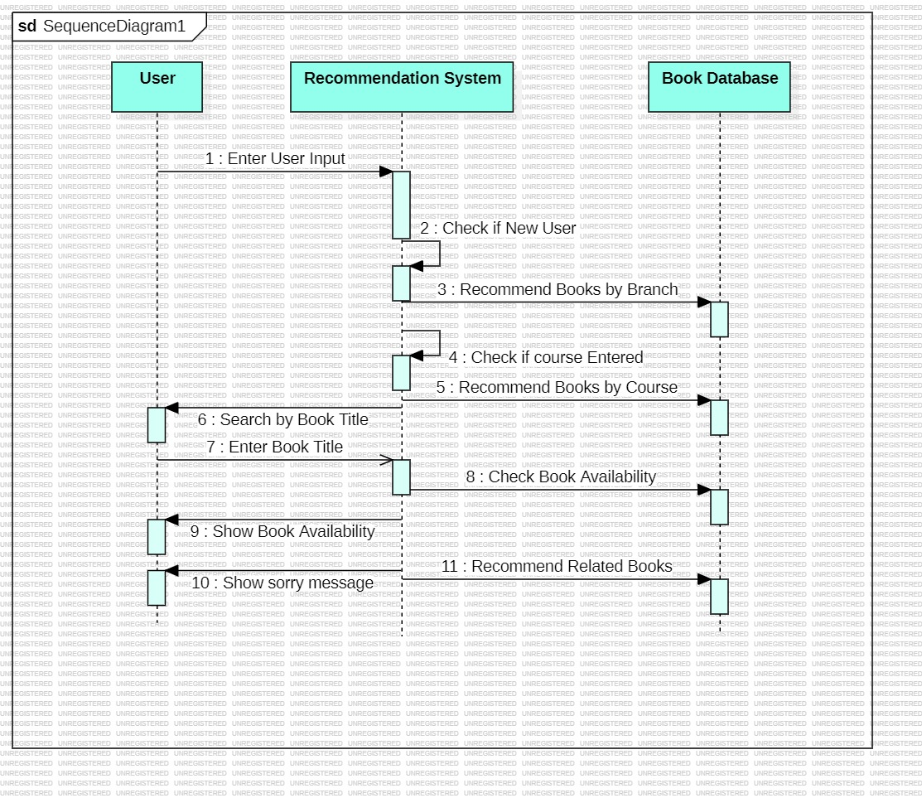
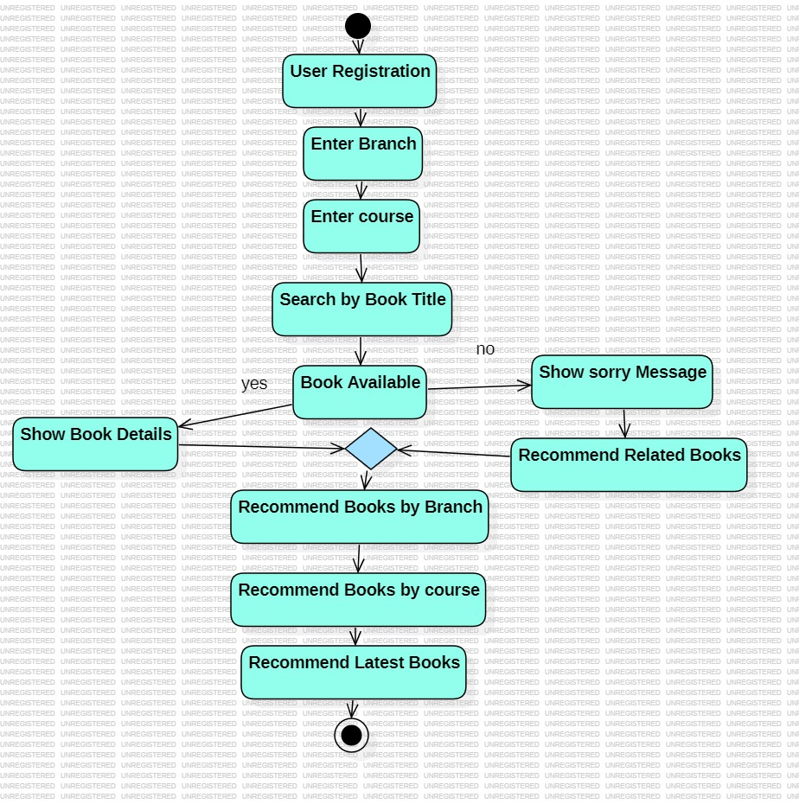
Fig: Sequence diagram
Fig:Activity diagram

Slide 17
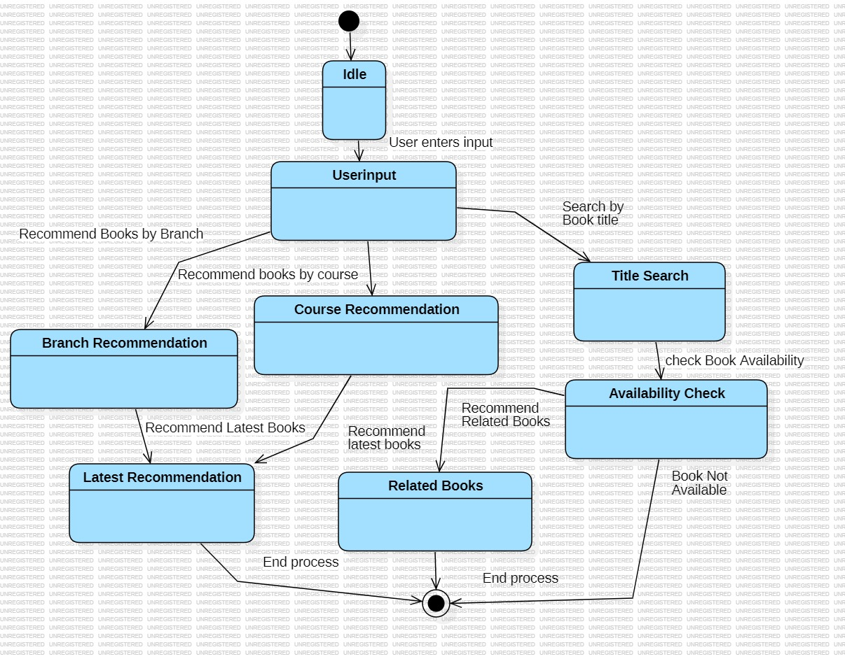
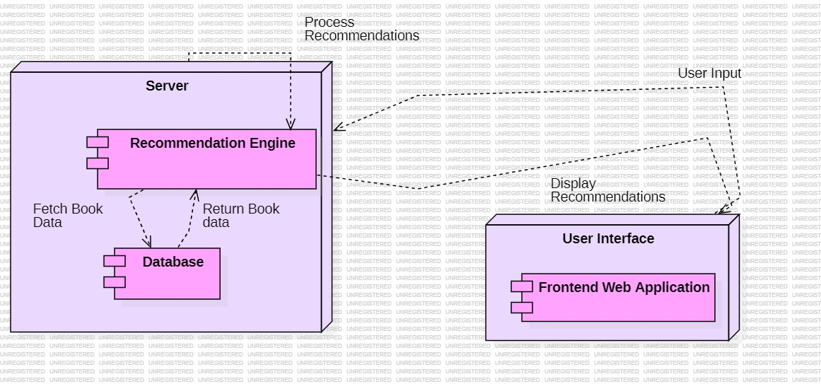
Fig: State chart diagram
Fig: Deployment diagram

Slide 18
METHODOLOGY
Data collection
Data Preprocessing
Content based filtering
Collaborative based filtering
Cold start solution
Recommendation and UI
Fig : Methodology diagram

Slide 19
ALGORITHAMS USED
CONTENT BASED FILTERING
Content-based filtering is a recommendation strategy that uses item attributes to suggest more items that are comparable to those in which a user has expressed interest. It works by analyzing information such as keywords, genres, or subjects within the content to detect similarities and recommend new content. this algorithm works by Cosine Similarity / TF-IDF (Term Frequency-Inverse Document Frequency) / Embedding-based Models
In the context of our engineering students' book recommendation system, content-based filtering work by analyzing the attributes of books like course relevance, branch, and descriptions to recommend similar books that align with each student's courses and interests. This way, if a student shows interest in books related to "software engineering," the system can suggest other books within that area

Slide 20
COLLABORATIVE BASED FILTERING : Collaborative-based filtering is a recommendation strategy that anticipates a user's preferences by aggregating preferences from multiple users. It operates on the assumption that customers who have previously agreed will most likely agree again in the future. In the context of increasing student engagement in engineering classes, collaborative-based filtering can be used to offer tailored books to students. By assessing a large number of students' reading habits and preferences and ratings of the books, the system can recommend books that other students have found useful or interesting. This tailored method can assist students in discovering relevant and engaging reading resources, ultimately boosting their learning experience and academic performance.

Slide 21
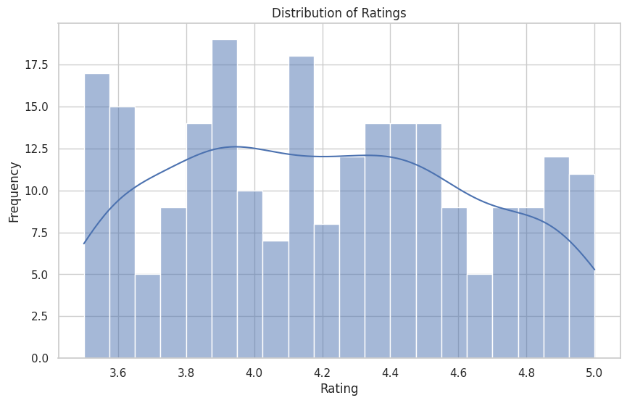
RESULTS
Fig: bar graph of book ratings distriubution

Slide 22
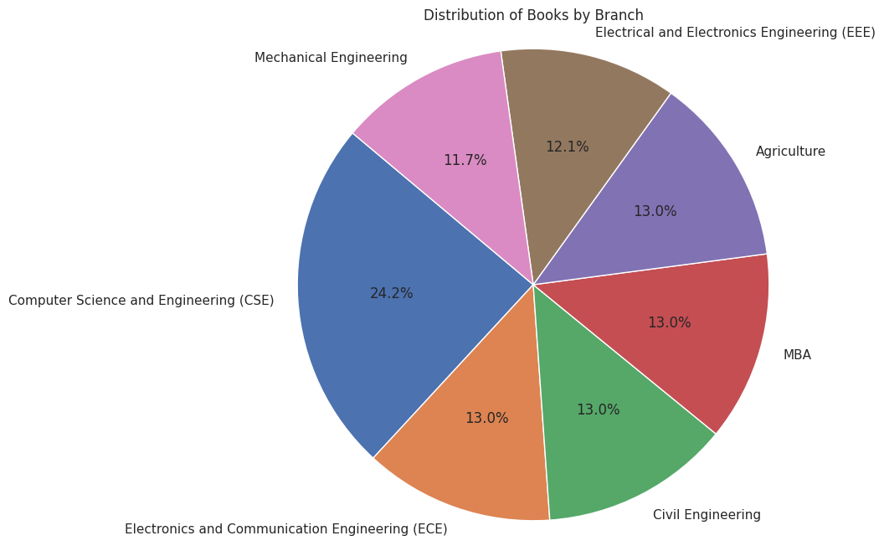
Fig: pie chart for distribution of books by branch

Slide 23
input | precision | recall | F1-Score
Math | 0.60 | 1.00 | 0.75
Computer Science | 0.60 | 1.00 | 0.75
Data Science | 0.60 | 1.00 | 0.75
Mechanical Engineering | 1.00 | 1.00 | 1.00
Table: comparison of different metrices using sample input
Average Precision: 0.70
Average Recall: 1.00
Average F1-Score: 0.81

Slide 24
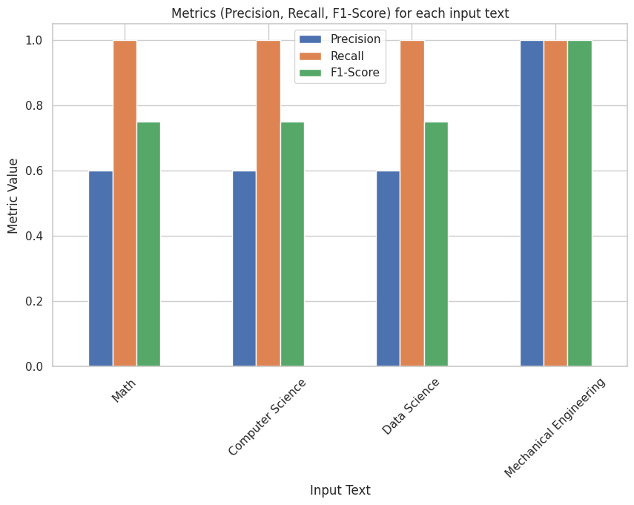
Fig :comparison of model performance by different metrices

Slide 25
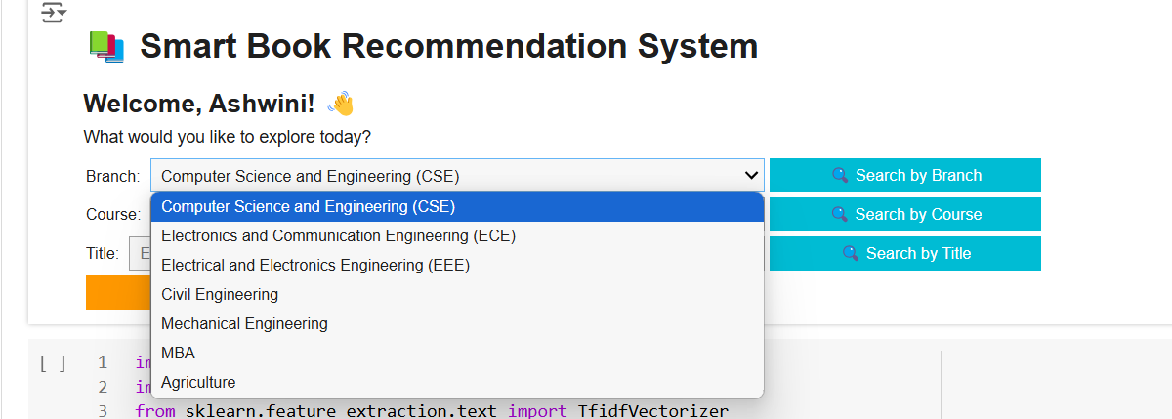
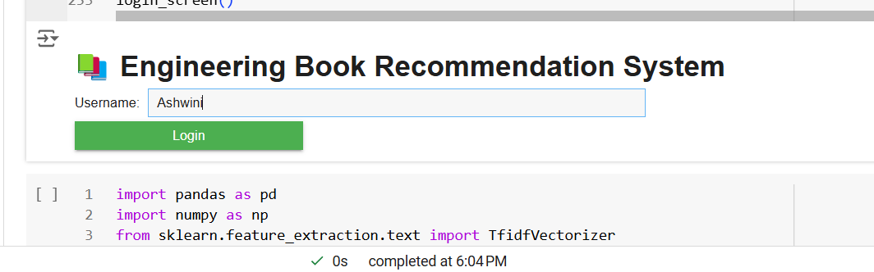
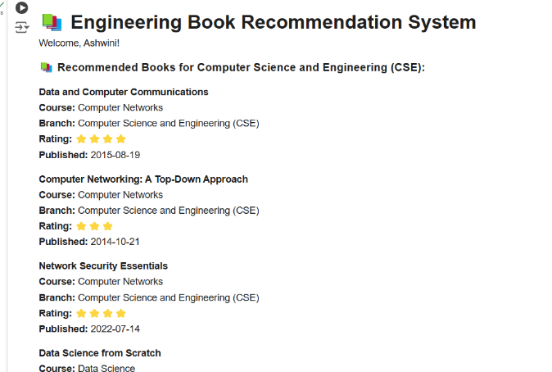
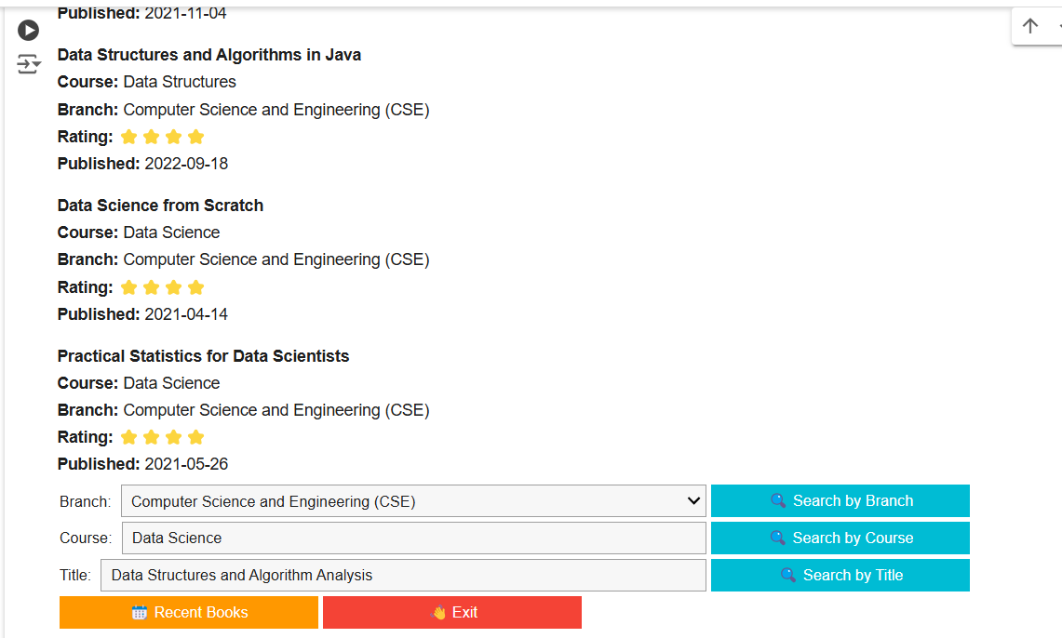
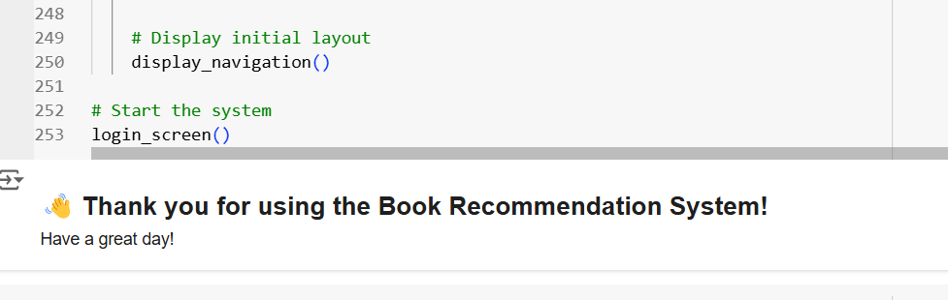
USER INTERFACE

Slide 26
CONCLUSION AND FUTURE SCOPE
CONCLUSION:our project engineering students' book recommendation system demonstrates promising results, with an Average Precision of 0.70, Average Recall of 1.00, and an Average F1-Score of 0.81. These metrics indicate that our system effectively retrieves relevant books and performs well in balancing precision and recall This performance suggests that the recommendation system is particularly strong in identifying relevant books for students.
FUTURE SCOPE: Future enhancements for this book recommendation system could include integrating additional data sources, such as academic journals, articles, and links to online resources, to provide a broader selection of study materials. Expanding the dataset with more comprehensive book metadata and student feedback can improve personalization and recommendation accuracy. Additionally, incorporating real-time updates to adapt recommendations based on trending topics or new courses could enhance system relevance and usability.

Slide 27
REFERENCES
[1] Roy, D., Dutta, M. A systematic review and research perspective on recommender systems. J Big Data 9, 59 (2022). https://doi.org/10.1186/s40537-022-00592-5
[2] Wu, S., Sun, F., Zhang, W., Xie, X., & Cui, B. (2022). Graph neural networks in recommender systems: a survey. ACM Computing Surveys, 55(5), 1-37.
[3] Kommineni, M., Alekhya, P., Vyshnavi, T. M., Aparna, V., Swetha, K., & Mounika, V. (2020, January). Machine learning based efficient recommendation system for book selection using user based collaborative filtering algorithm. In 2020 Fourth International Conference on Inventive Systems and Control (ICISC) (pp. 66-71). IEEE.
[4] Cui, B., & Chen, X. (2009, August). An online book recommendation system based on web service. In 2009 Sixth International Conference on Fuzzy Systems and Knowledge Discovery (Vol. 7, pp. 520-524). IEEE.
[5] Tewari, A. S., Kumar, A., & Barman, A. G. (2014, February). Book recommendation system based on combine features of content based filtering, collaborative filtering and association rule mining. In 2014 IEEE International Advance Computing Conference (IACC) (pp. 500-503). IEEE.

Slide 28
[6] Sohail, S. S., Siddiqui, J., & Ali, R. (2013, August). Book recommendation system using opinion mining technique. In 2013 international conference on advances in computing, communications and informatics (ICACCI) (pp. 1609-1614). IEEE.
[7] Jomsri, P. (2014, August). Book recommendation system for digital library based on user profiles by using association rule. In Fourth edition of the International Conference on the Innovative Computing Technology (INTECH 2014) (pp. 130-134). IEEE.
[8] Kanetkar, S., Nayak, A., Swamy, S., & Bhatia, G. (2014, August). Web-based personalized hybrid book recommendation system. In 2014 International Conference on Advances in Engineering & Technology Research (ICAETR-2014) (pp. 1-5). IEEE.
[9] Kurmashov, N., Latuta, K., & Nussipbekov, A. (2015, September). Online book recommendation system. In 2015 Twelve International Conference on Electronics Computer and Computation (ICECCO) (pp. 1-4). IEEE.
[10] Kusumawardhani, N. K., Nasrun, M., & Setianingsih, C. (2019, December). Web Recommended System Library Book Selection Using Item Based Collaborative Filtering Method. In 2019 IEEE International Conference on Engineering, Technology and Education (TALE) (pp. 1-8). IEEE.

Slide 29

THANK YOU!

